Slide 1
Signal and System
Assignment

Slide 2
Group Members: Enrollment Number:
1.Sayak Rana. 510519108
2.Abhiroop Mukherjee. 510519109
3.Hritick Sharma. 510519114

Slide 3
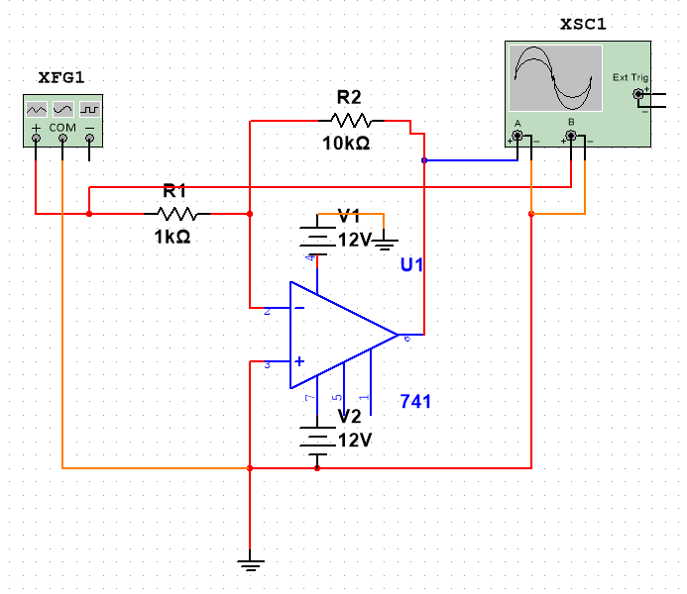
1) First of all, implement a simple inverting amplifier. Check whether the gain (V_out/V_in) remains linear over a range of input voltage. Try to plot the gain against a swing of input voltage for this.
Circuit:

Slide 4
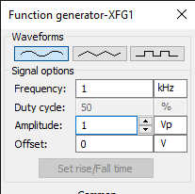
Input:1

Slide 5
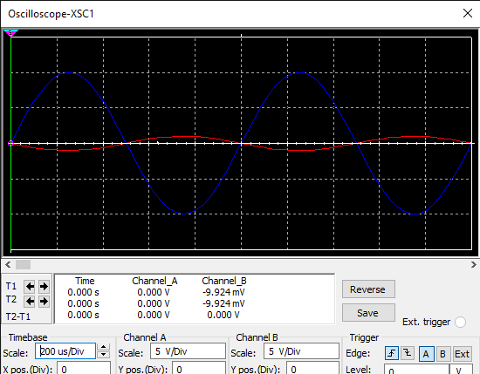
Output :1

Slide 6
Explanation to Output
As R1 = 1kOhm and R2 = 10kOhm
Proportionality Factor = - 10/1 = -10
Hence the output will be inverted and scaled 10 time

Slide 7
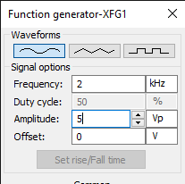
Input :2

Slide 8
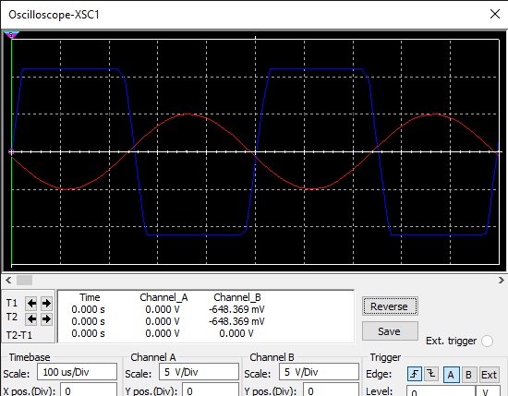
Output :2

Slide 9
Explanation to Output
Proportionality Factor = -10
But as V_in has Amplitude 5, V_out will have Amplitude 50
But the opamp cant amplify past 12V
So any value above 12V will be displayed as 12V only

Slide 10
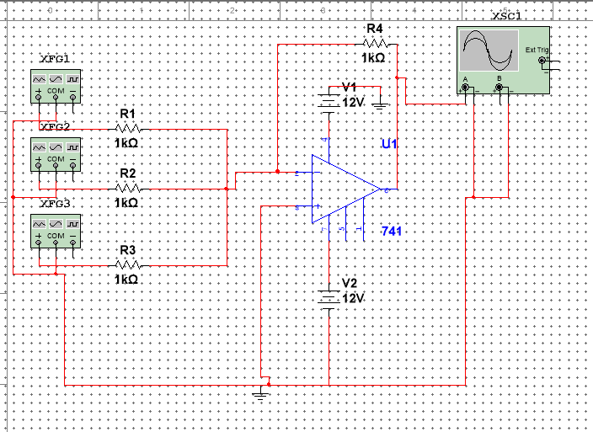
2) Then implement few designer opamps that produce a linear combination of two input voltages at the output. Check different alternatives like sum and differences.
Addition circuit:

Slide 11
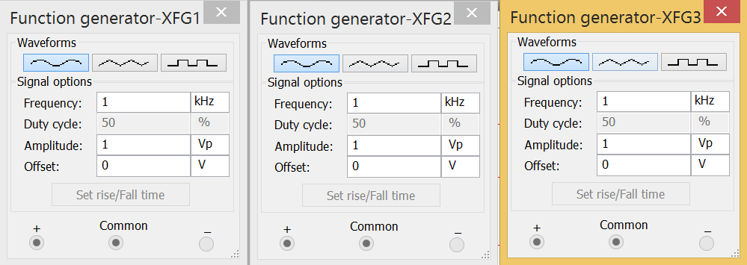
Addition input:

Slide 12
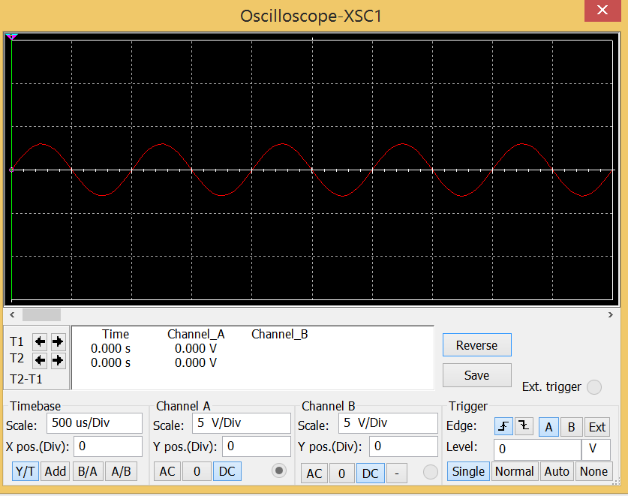
Addition output:

Slide 13
Explanation to Output
As all of the three inputs have amplitude 1 and frequent 1kHz, The Output will have Amplitude 3 and same frequency

Slide 14
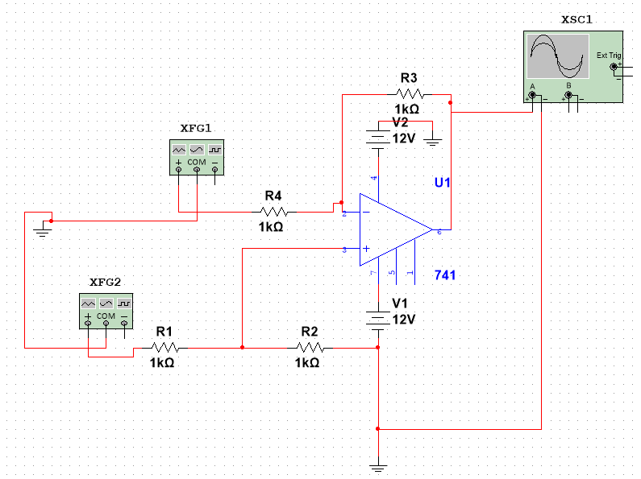
Subtraction circuit:

Slide 15

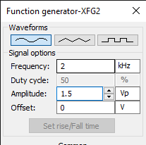
Subtractor input:

Slide 16
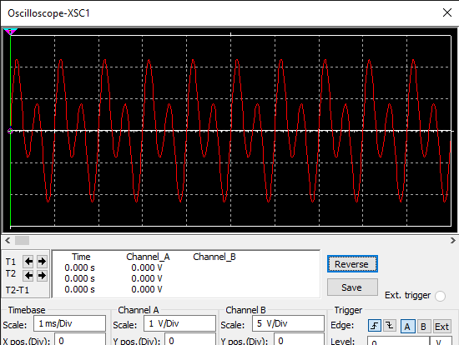
Output:

Slide 17
Explanation to Output
As both of the input has different frequency and Amplitude, The output will be superposition of their graphs

Slide 18
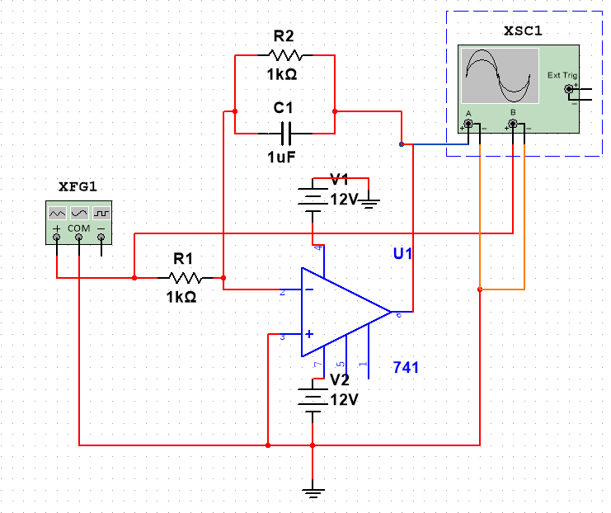
3) Now implement the integrator circuit and also the PI circuit. Check the output for different input voltage profiles.
Integrator circuit:

Slide 19
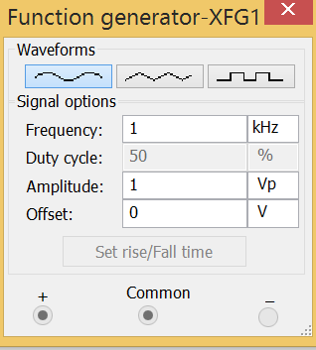
Integrator Input:

Slide 20
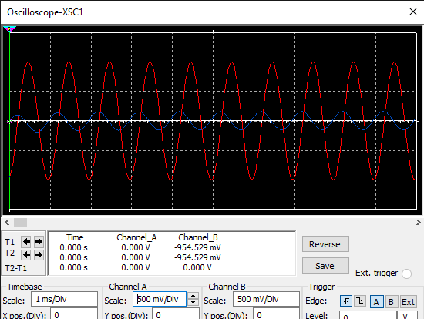
Integrator Output:

Slide 21
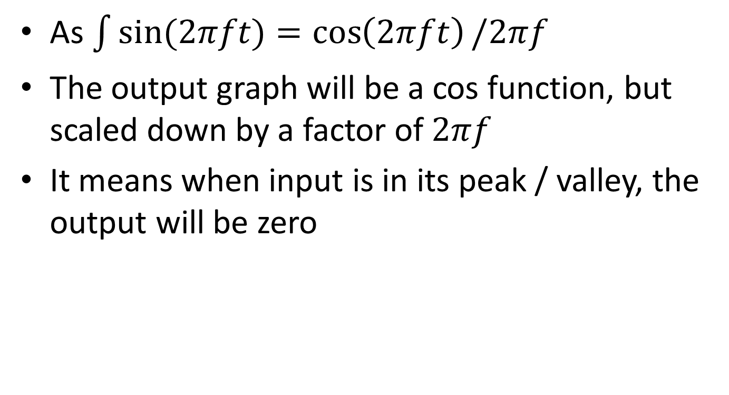
Explanation of Output
As $\int{sin⁡(2πft)}{=\cos\left(2πft\right)/2πf}$
The output graph will be a cos function, but scaled down by a factor of $2πf$
It means when input is in its peak / valley, the output will be zero

Slide 22
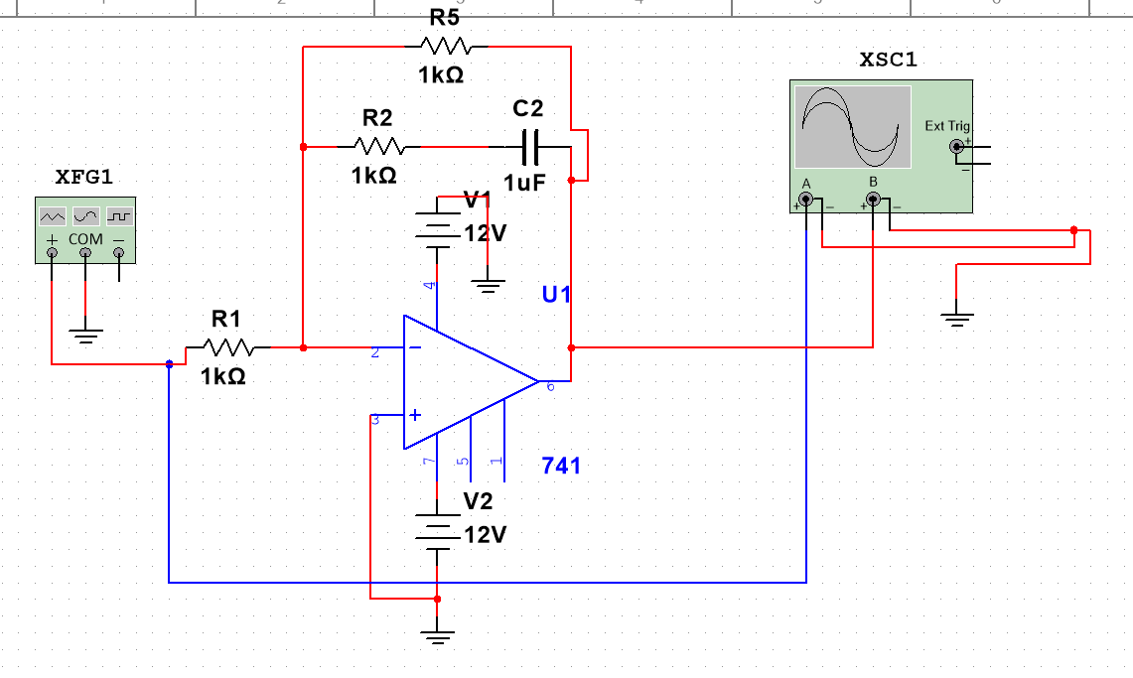
PI Circuit:

Slide 23
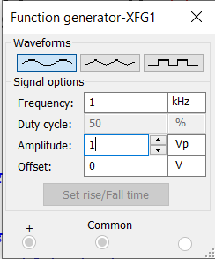
PI Input 1:

Slide 24
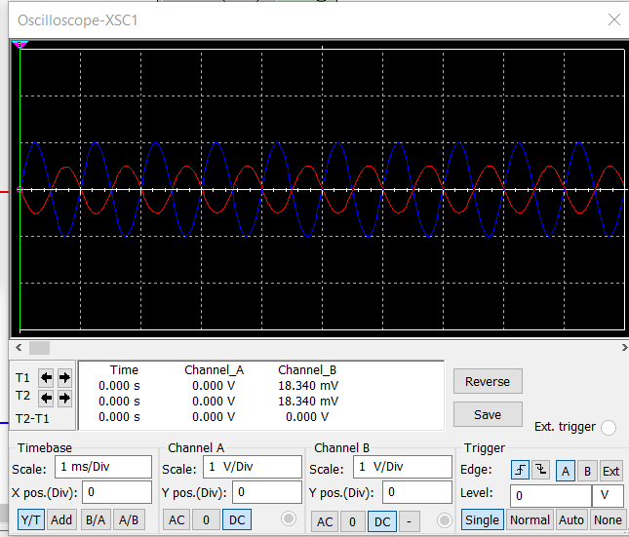
PI Output 1:

Slide 25
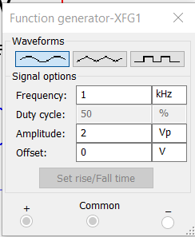
PI Input 2:

Slide 26

PI Output 2:

Slide 27
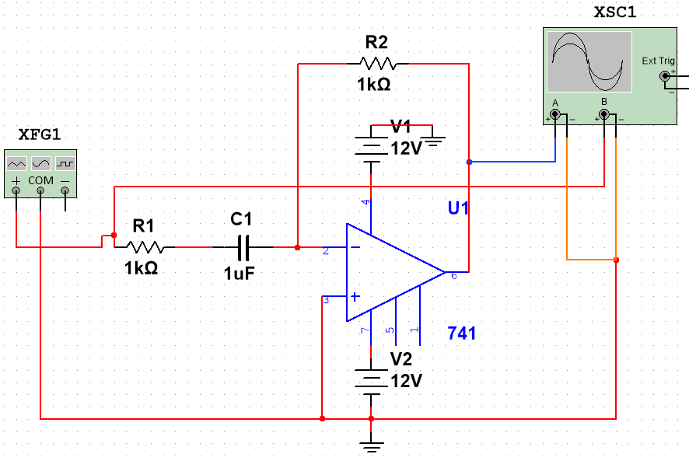
4)Now implement the differentiator circuit and the PD circuit. Check the output for different input voltage profiles.
Differentiator circuit:

Slide 28
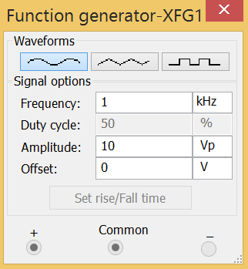
Differentiator input:

Slide 29
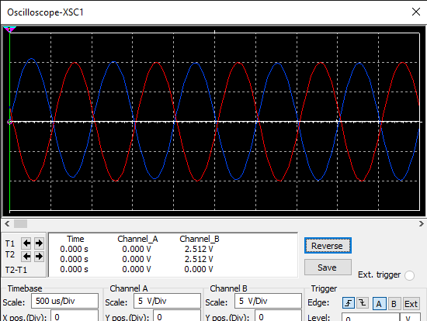
Differentiator output:

Slide 30
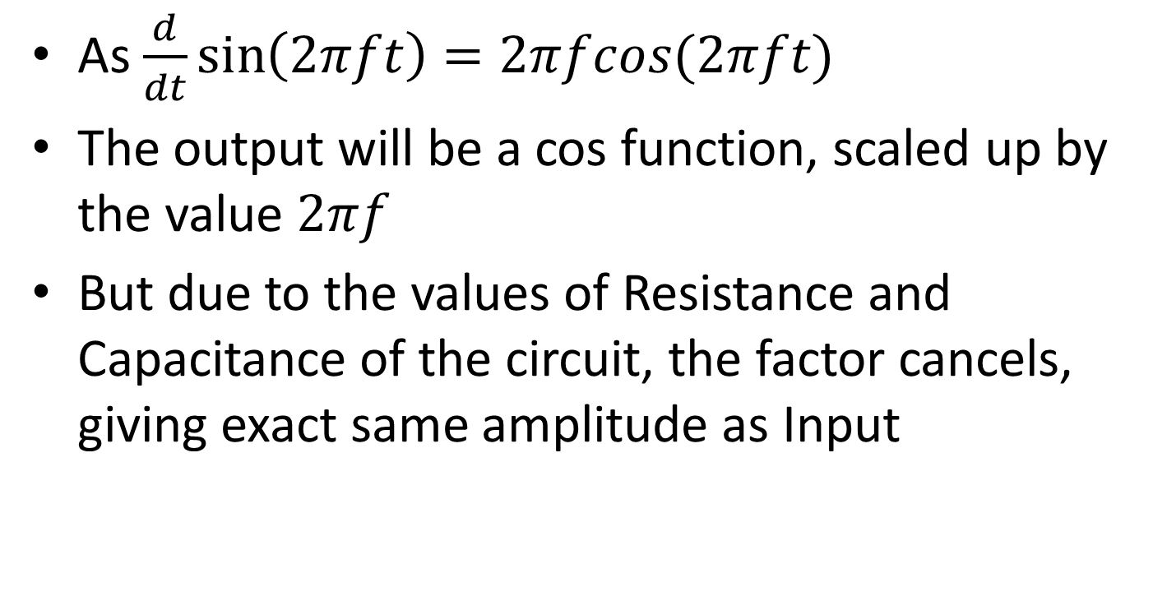
Explanation of Output
As $\frac{d}{dt}\sin\left(2πft\right)=2πfcos(2πft)$
The output will be a cos function, scaled up by the value $2πf$
But due to the values of Resistance and Capacitance of the circuit, the factor cancels, giving exact same amplitude as Input

Slide 31
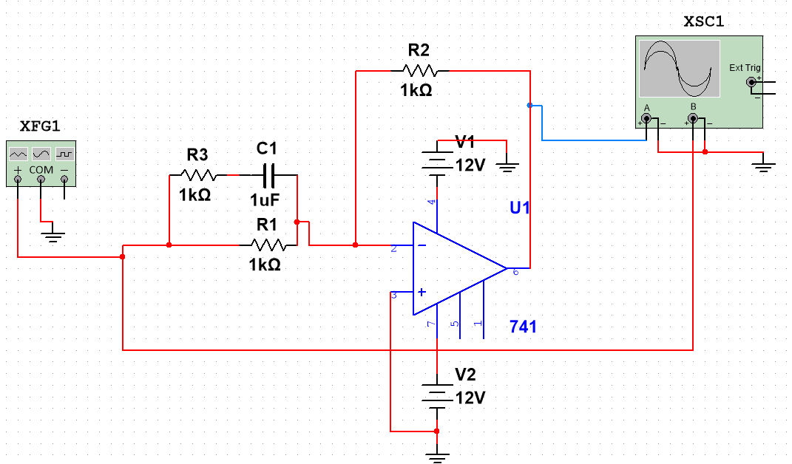
PD Circuit:

Slide 32
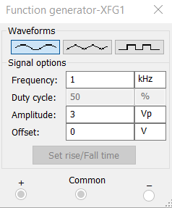
PD Input 1:

Slide 33
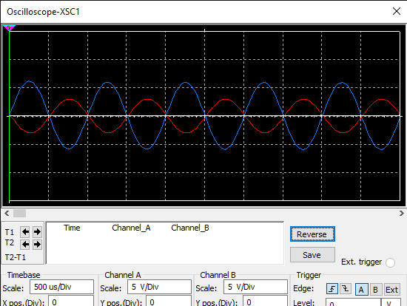
PD Output 1:

Slide 34
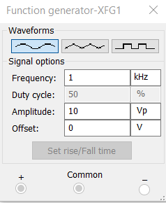
PD Input 2:

Slide 35
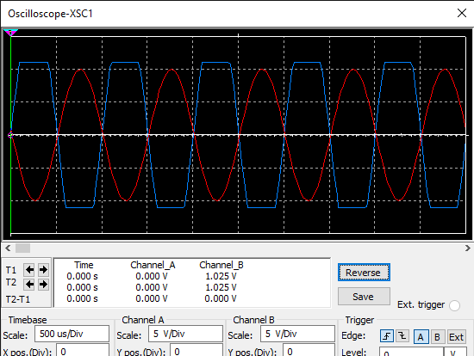
PD Output 2:

Slide 36
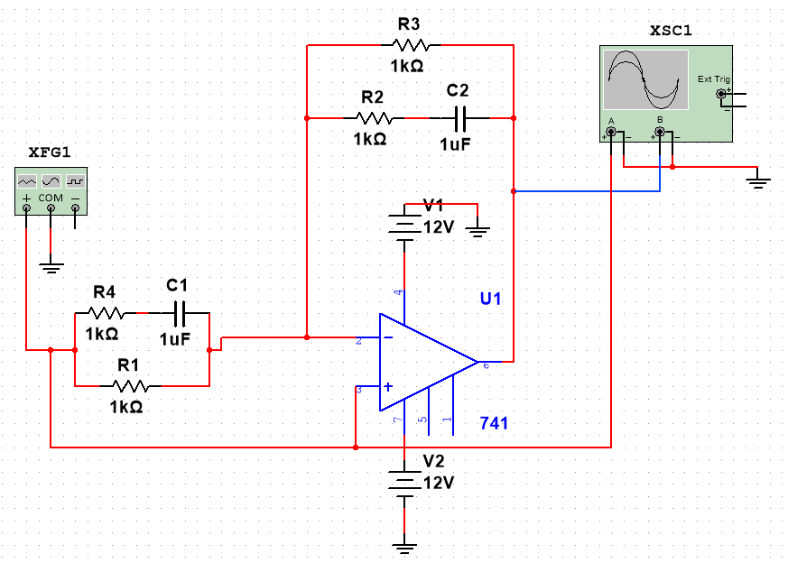
5)Finally implement the PID amplifier and show its performance in time domain for various input signal profiles.
PID Amplifier Circuit:

Slide 37
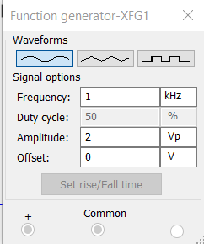
PID Amplifier Input 1:

Slide 38
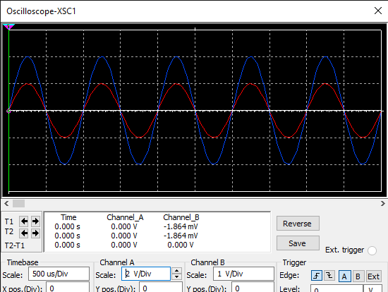
PID Amplifier Output 1:
Here Scales of the two plots have been changed as they are equal

Slide 39
Explanation of Output
Proportionality of sine function is sine
Integral of sine function is –cosine
Differentiation of sine function is cosine
Hence when P, I, D of this input will be added, only sine will remain, giving the exact same output as the input

Slide 40
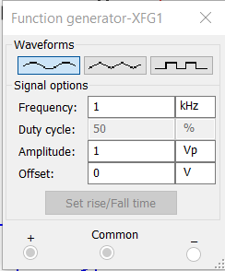
PID Amplifier Input 2:

Slide 41
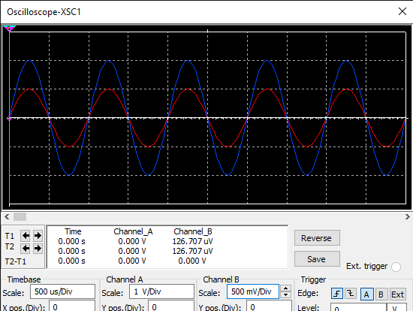
PID Amplifier Output 2:
Here Scales of the two plots have been changed as they are equal

Slide 42
Thank You

